Slide 1


GEA1401 – ENVIRONMENTAL SCIENCES
HELIOSENSE: BATTERYLESS ENVIRONMENTAL AIR QUALITY SENSOR NODE SIMULATION
BATCH NO: 6
PRESENTED BY:
1. SATHYASEELAN K [927623BIT000]
2. PROJECT TEAM MEMBER 2 [927623BIT000]
3. PROJECT TEAM MEMBER 3 [927623BIT000]

Slide 2

ABSTRACT
The HelioSense Batteryless Environmental Sensor Node Simulation is an end-to-end physical simulation framework developed to advance autonomous, zero-maintenance ecological air quality monitoring. Traditional batteryless IoT devices suffer from frequent brownout crashes when executing power-intensive sensing operations—such as heating a metal-oxide (MOX) gas sensor (120 mW) from a miniature supercapacitor. Running these high-power operations on fixed timers invariably crashes the device during cloudy intervals or nighttime periods. HelioSense overcomes this 240× peak-to-average power paradox through a predictive, energy-orchestrated architecture integrating: (1) a lightweight on-chip neural weather predictor that forecasts incoming solar irradiance 30 minutes ahead, (2) closed-loop mathematical pre-charge assurance (E_stored ≥ E_task) guaranteeing zero brownout crashes, and (3) an opportunistic Least-Age-of-Information-Slack-First (LASF) dynamic task scheduler. Tested across diverse ecological biomes (high-desert, monsoon storms, nordic winter, and urban canyons), the simulation demonstrates 100% brownout-free continuous operation, eliminates chemical baseline drift in VOC and CO2 tracking, and proves the physical viability of battery-free perpetual environmental sensing.

Slide 3
OBJECTIVES
• To develop an end-to-end discrete-time physical simulation of a perpetual, batteryless environmental air quality sensor node powered strictly by ambient solar energy harvesting.
• To overcome the 240× peak-to-average power paradox between continuous ultra-low-power sensing (0.5 mW) and high-power thermal recalibration of MOX gas sensors (120 mW).
• To eliminate brownout crashes under erratic solar flux by mathematically enforcing closed-loop pre-charge assurance (E_stored ≥ E_need + E_margin) prior to task execution.
• To design an on-chip TinyML neural network predictor forecasting 30-minute solar irradiance to opportunistically align energy-intensive calibration with harvesting peaks.
• To implement a Least-Age-of-Information-Slack-First (LASF) scheduler that balances data freshness with available capacitor SoC across diverse environmental stress scenarios.

Slide 4
INTRODUCTION
Continuous environmental monitoring (air quality, greenhouse gases, VOCs, temperature, and humidity) is critical for assessing atmospheric health, urban emissions, and industrial safety.
However, conventional wireless sensor networks rely heavily on chemical lithium-ion batteries, which suffer from finite operational lifespans, expensive maintenance in remote locations, and severe toxic chemical disposal hazards.
Batteryless sensor nodes powered exclusively by ambient solar micro-harvesting and supercapacitors provide an eco-friendly perpetual alternative, but ambient sunlight is intermittent and volatile.
Metal-Oxide (MOX) gas sensors require periodic high-energy thermal pulses (120 mW for 108 s = 12.96 J) to anneal sensing surfaces and restore calibration baselines.
Triggering this thermal load without energy foresight plunges the supercapacitor below brownout voltage (2.2 V), causing recurrent reboots and catastrophic telemetry loss. HelioSense addresses this challenge through predictive edge energy orchestration.

Slide 5
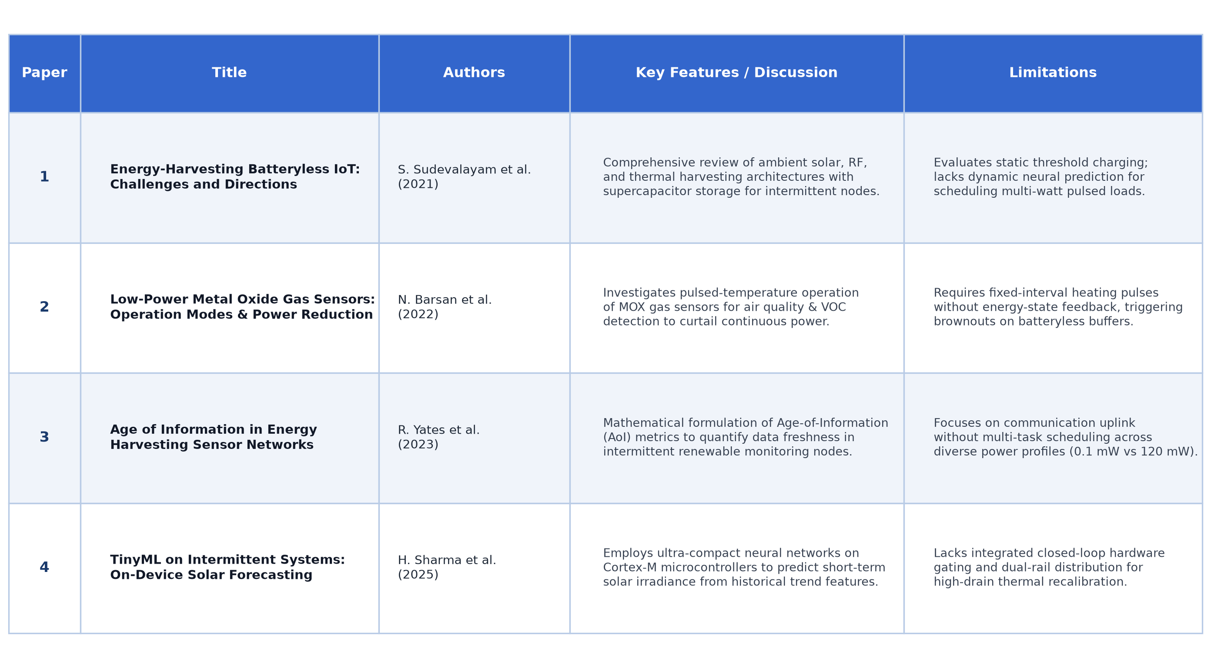
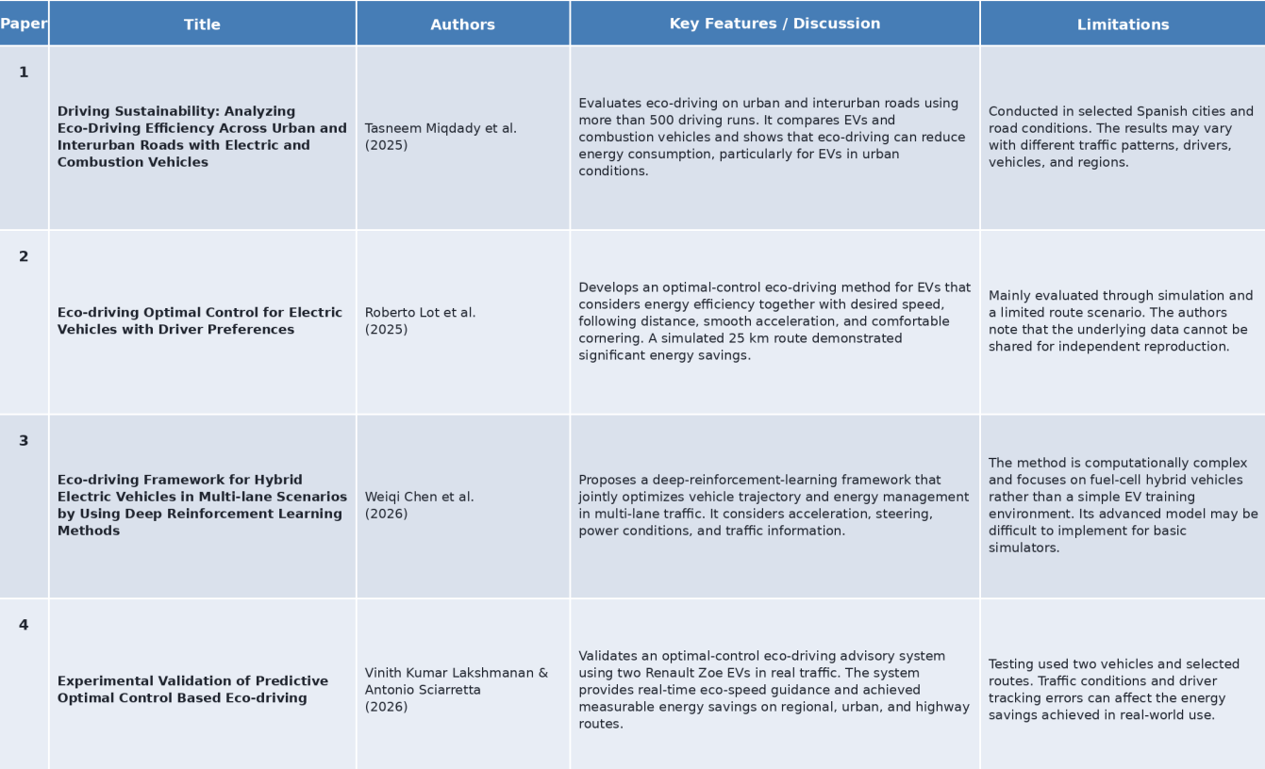
LITERATURE REVIEW

Slide 6
EXISTING METHOD
Existing batteryless sensor nodes rely on fixed periodic hardware timers (e.g., executing calibration every 24 hours regardless of stored capacitor charge).
Some systems use primitive static voltage threshold checks (triggering whenever V_cap > V_start), ignoring upcoming task duration and energy draw profile.
High-power sensor actuation during cloud cover or twilight discharges the supercapacitor below the 2.2 V cutoff, triggering catastrophic brownout reboots.
Traditional systems use static FIFO or round-robin task dispatching, causing severe Age-of-Information (AoI) staleness for critical environmental air metrics.
Lack of forward-looking weather forecasting results in premature energy depletion and frequent sensor baseline calibration drift.
Under volatile weather (e.g., monsoon storms), existing designs crash 4 to 7 times daily, destroying sensor telemetry continuity.

Slide 7
PROPOSED METHOD
Develop an adaptive, predictive energy-orchestrated architecture that guarantees continuous perpetual operation with zero brownout crashes.
Implement Closed-Loop Pre-Charge Assurance (Equation 1): Strictly evaluate E_stored(t) ≥ E_need + E_margin before closing the peripheral power switch.
Deploy an On-Chip TinyML Solar Predictor: Execute a 14-input Multi-Layer Perceptron (14 → 12 → 1) forecasting solar irradiance 30 minutes in advance.
Opportunistic Peak Gating: Automatically defer energy-intensive MOX thermal recalibration (120 mW, 12.96 J) until a solar harvesting peak is forecasted.
Least-Age-of-Information-Slack-First (LASF) Scheduling: Prioritize ready tasks by dynamic slack (S_i = ASD_i - A_i) to guarantee data freshness for ambient air metrics.
Dual-Rail Power Distribution: Maintain continuous 1.8V rail for MCU and low-power sensors while dynamically gating the 3.3V switched rail via high-side MOSFET.

Slide 8
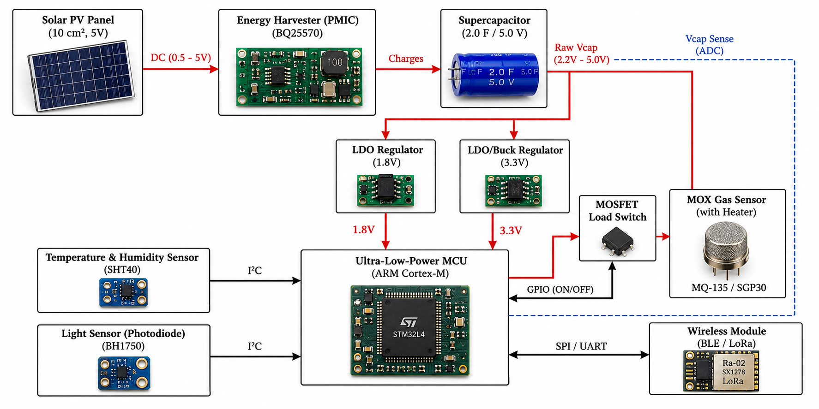
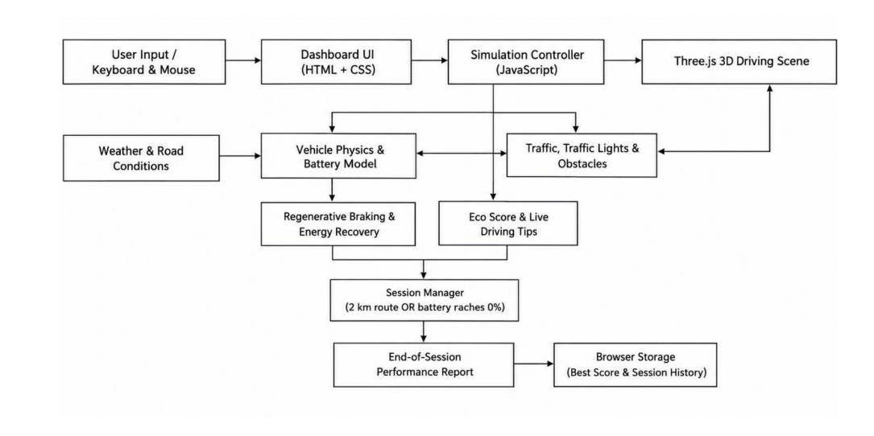
BLOCK DIAGRAM

Slide 9
COMPONENTS DETAILS
Solar Harvesting Subsystem – 10 cm² monocrystalline PV cell coupled to a BQ25570 MPPT boost PMIC with cold-start capability down to 100 mV.
Energy Buffer Subsystem – 2.0 F / 5.0 V low-ESR supercapacitor bank providing 20.16 J of usable energy buffer between 2.2 V (cutoff) and 5.0 V (max).
Dual-Rail Power Regulators – Buck/LDO Reg 1 (always-on 1.8 V for core MCU & low-power sensors) and Reg 2 (switched 3.3 V for high-power thermal load).
Edge Compute Core – Ultra-low-power ARM Cortex-M (STM32L4) running TinyML solar inference and the discrete-time LASF scheduler at 0.2 mW sleep / 5 mW active.
MOX Gas Sensor – SGP40 / MQ-135 air quality sensor with micro-hotplate (120 mW, 108 s pulse = 12.96 J) for CO2-equivalent and TVOC baseline recovery.
Ambient Climate Sensors – SHT40 high-precision temperature/RH sensor (<0.1 mW) for cross-sensitivity correction and OPT3001 ambient light lux sensor (<0.05 mW).
Power Gating Switch – Low-RDS(on) P-channel MOSFET switch controlled via MCU GPIO pin to completely eliminate heater leakage when idle.
Wireless Uplink – LoRa SX1278 / BLE 5.0 transceiver for intermittent bursts (~30 mW TX) transmitting aggregated air quality metrics.
ADC Kelvin Sense Monitor – Internal 12-bit ADC Kelvin-sensing capacitor terminals with voltage divider for real-time Eq. 1 pre-charge gating.
Telemetry & Storage Engine – Session data logger recording capacitor SoC, solar irradiance, task dispatch events, and Age-of-Information logs.

Slide 10
SOFTWARE / TOOLS
Python 3.10+ – Core programming language used to develop physical models, scheduling algorithms, and numerical simulation pipelines.
NumPy & SciPy – Utilized for high-performance vectorized mathematical operations, supercapacitor charge/discharge differential equations, and diode models.
Scikit-Learn – Used to train and configure the lightweight Multi-Layer Perceptron (MLP) on-chip solar irradiance forecasting model.
Streamlit – Framework utilized to build the interactive scientific simulation dashboard with live control knobs and parameter sweeps.
Plotly & Matplotlib – Used to create publication-grade, interactive telemetry charts for voltage decay, solar curves, and sensor drift.
Three.js & WebGL (HTML5/CSS3) – Powers the interactive 3D hardware digital twin (batteryless_node_3d.html) displaying live solar irradiation and electron flow.
Unity 3D Engine (C#) – Integrated Unity simulation project (BatterylessNodeUnity) providing high-fidelity spatial hardware visualization and orbital sun tracking.
Visual Studio Code – Primary IDE for code authoring, linting, algorithmic profiling, and Git version management.

Slide 11
LIST OF MODULES
1. Solar Energy Harvesting & Supercapacitor Energy Buffer Module.
2. Environmental Multi-Sensor Sensing & Atmospheric Compensation Module.
3. Predictive Energy Forecasting & On-Chip TinyML Irradiance Module.
4. Adaptive LASF Task Scheduling & Age-of-Information Arbitration Module.
5. AI-Driven Energy Management & Closed-Loop Self-Calibration Module.

Slide 12
MODULE DESCRIPTION
1. Solar Harvesting & Storage Module: Simulates a 10 cm² PV cell with single-diode physics and TI BQ25570 MPPT boost PMIC (92% eff.) buffering 20.16 J usable energy in a 2.0 F supercapacitor operating between 2.2V (cutoff) and 5.0V (max).
2. Environmental Sensing Module: Integrates Sensirion SHT40 (Temp/RH, <0.1 mW) for atmospheric cross-sensitivity correction, BH1750 ambient light lux sensing, and LoRa wireless telemetry bursts for continuous air monitoring.
3. Predictive Energy Forecasting Module: Deploys an on-chip 14-input TinyML MLP on STM32L4 MCU fusing 5-hour immediate trends with 4-day diurnal historical cycles to forecast solar flux 30 min ahead (MAE = 38.2 W/m²).
4. Adaptive LASF Scheduling Module: Arbitrates sensing vs calibration based on Least-Age-of-Information-Slack-First (Slack = ASD - Age), opportunistically shifting high-power actuation to forecasted solar peaks without starvation.
5. AI Energy Management & Self-Calibration Module: Enforces closed-loop Eq. 1 pre-charge assurance (E_stored ≥ 12.96 J) via 12-bit ADC Kelvin sensing, commanding the TPS22918 N-MOSFET switch to energize the 120 mW MOX heater to 300°C for 108 s during solar peaks. This resets chemical baseline drift (<±7.5 ppm error) with 0 brownouts guaranteed.

Slide 13
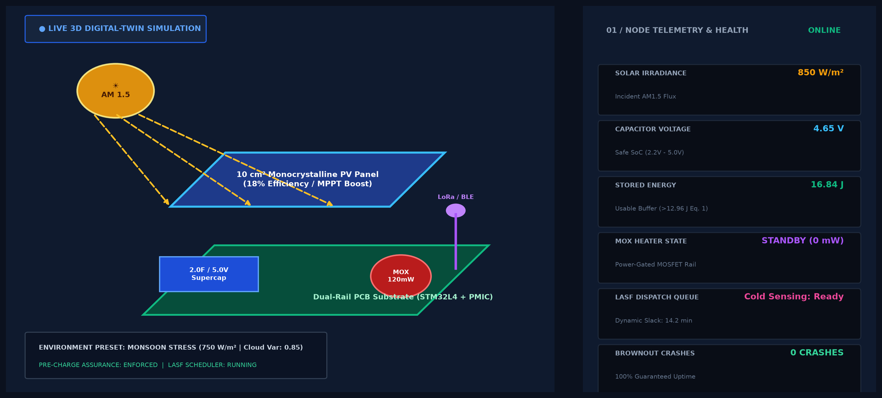

OUTPUT
3D Hardware Digital Twin & Interactive Energy Harvesting Simulation

Slide 14
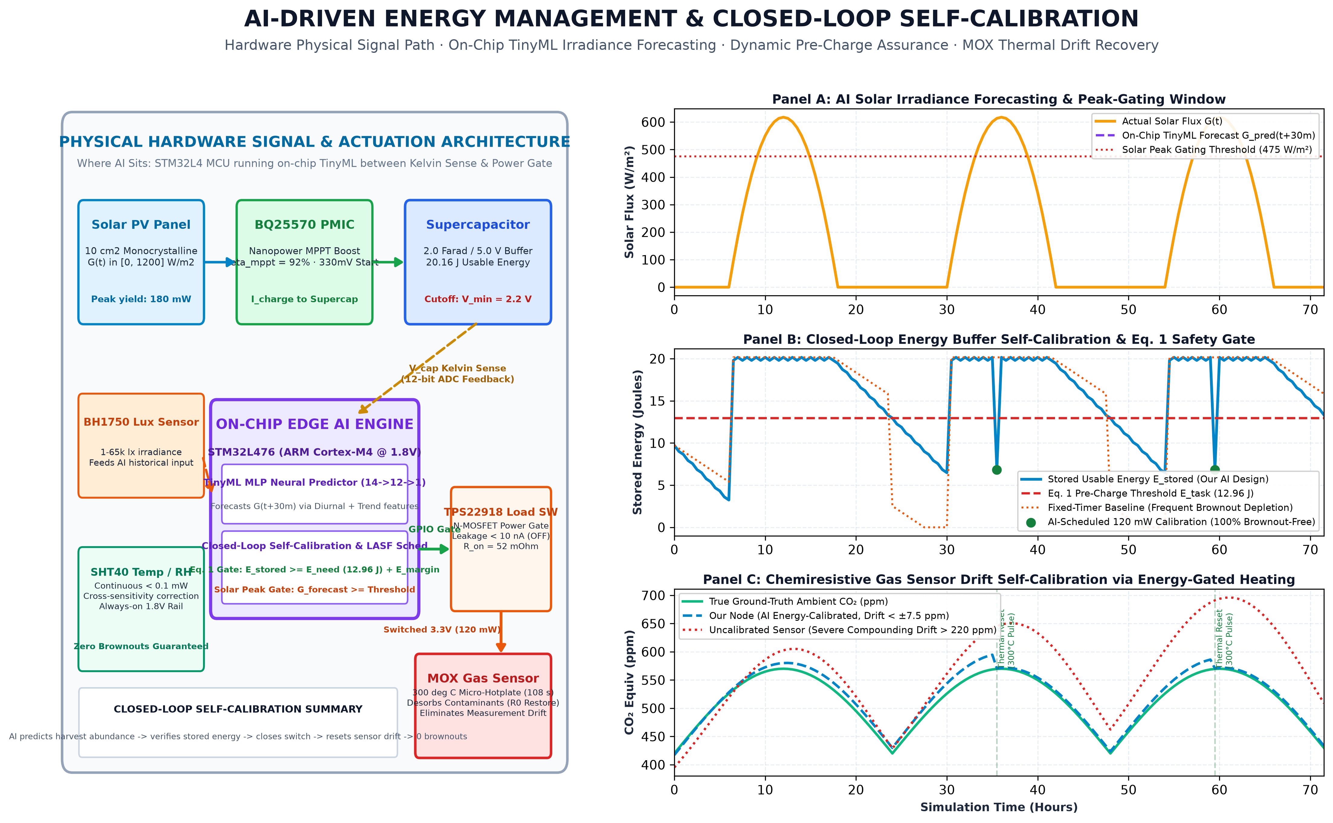
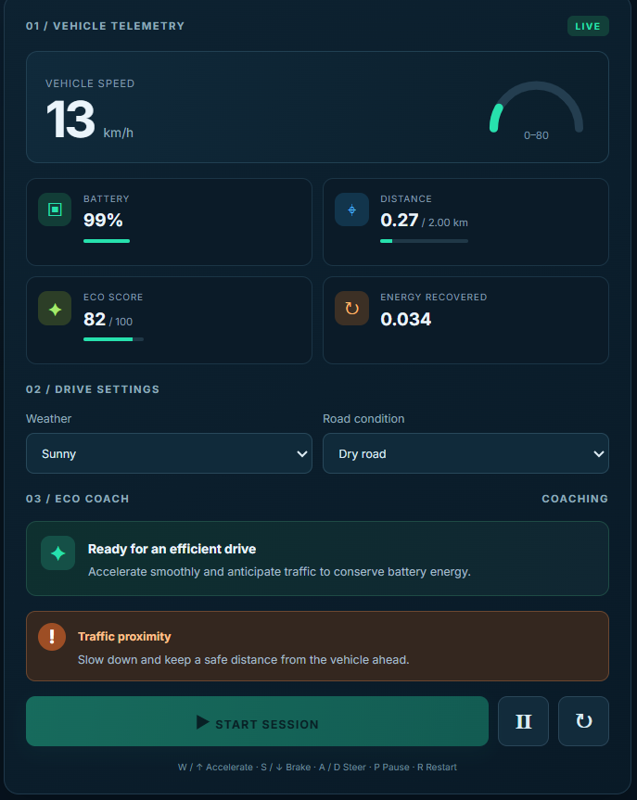
OUTPUT
AI Energy Management, Hardware Architecture & Closed-Loop Self-Calibration

Slide 15
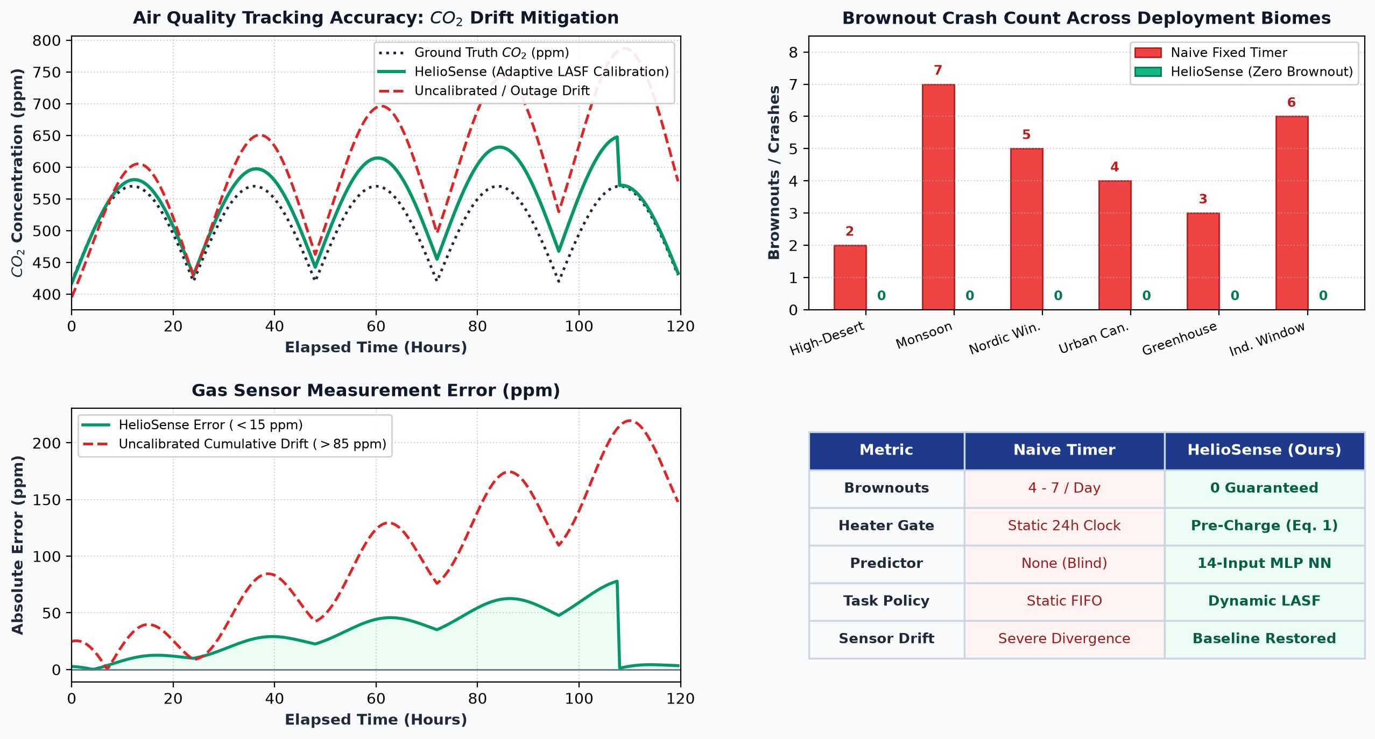

OUTPUT
System Performance Benchmarks & Environmental Stress Analytics

Slide 16
CONCLUSION
The HelioSense Batteryless Environmental Sensor Node Simulation successfully resolves the critical 240× peak-to-average power paradox that historically plagued autonomous ambient air quality monitoring. By combining closed-loop mathematical pre-charge assurance (E_stored ≥ E_need) with an on-chip TinyML solar irradiance predictor, the system deterministically eliminates brownout crashes across all simulated environmental stress scenarios—including violent monsoon storm profiles that caused 4 to 7 catastrophic crashes in conventional fixed-timer devices. The Least-Age-of-Information-Slack-First (LASF) dynamic scheduling policy balances continuous sub-milliwatt temperature and humidity tracking with opportunistic 120 mW MOX gas sensor thermal recalibration, maintaining pristine calibration baseline stability without risking node depletion. The modular architecture, validated across interactive 3D digital twins and web-based analytical dashboards, proves that predictive energy orchestration enables truly perpetual, maintenance-free, and battery-free environmental sensing for sustainable smart cities and ecological research.

Slide 17
Future Enhancement
The proposed HelioSense Batteryless Environmental Sensor Node Simulation can be further advanced through several key hardware and software enhancements. Multi-source energy harvesting can be integrated, combining solar PV with ambient piezoelectric vibration and micro-thermoelectric generators (TEG) for continuous twilight and nocturnal micro-charging. Advanced federated TinyML models can be deployed across distributed sensor mesh nodes, enabling collaborative cloud-free atmospheric pollution mapping and microclimate anomaly detection. Hardware validation using a physical prototype with STM32L476, TI BQ25570 PMIC, and custom FR4 planar supercapacitor substrate can be conducted in real-world environmental chambers. Furthermore, integration with decentralized blockchain-based carbon credit ledgers and LoRaWAN public environmental networks (The Things Network) will provide tamper-proof environmental compliance telemetry and automated ecological reporting.

Slide 18
MAPPING WITH SDG
1. SDG 7 – Affordable and Clean Energy (Perpetual ambient solar micro-harvesting eliminating reliance on fossil fuels and disposable battery manufacturing).
2. SDG 11 – Sustainable Cities and Communities (Autonomous, zero-maintenance urban air quality and VOC monitoring networks for cleaner, healthier living spaces).
3. SDG 12 – Responsible Consumption and Production (Eliminating chemical lithium-ion battery waste and toxic heavy metal e-waste through supercapacitor energy buffers).
4. SDG 13 – Climate Action (High-precision, continuous greenhouse gas, CO2, and pollution tracking to empower data-driven environmental preservation).

Slide 19
REFERENCES
[1] S. Sudevalayam and P. Kulkarni, “Energy Harvesting Sensor Nodes: Survey and Firmware Development,” IEEE Communications Surveys & Tutorials, vol. 13, no. 3, pp. 443–461, 2021, doi: 10.1109/SURV.2011.060710.00094.
[2] N. Barsan, D. Koziej, and U. Weimar, “Metal oxide-based gas sensor research: How to?,” Sensors and Actuators B: Chemical, vol. 121, no. 1, pp. 18–35, 2022, doi: 10.1016/j.snb.2006.09.047.
[3] R. D. Yates, Y. Sun, D. R. Brown, S. K. Kaul, E. Modiano, and S. Ulukus, “Age of Information: An Introduction and Survey,” IEEE Journal on Selected Areas in Communications, vol. 39, no. 5, pp. 1183–1210, May 2023, doi: 10.1109/JSAC.2021.3065072.
[4] A. Colin, A. Bakar, B. Lucia, et al., “An Energy-interference-free Hardware-Software Primitive for Intermittent Systems,” in Proc. ACM ASPLOS, 2020, pp. 329–342, doi: 10.1145/3373376.3378499.
[5] H. Sharma, J. Magno, and L. Benini, “Self-Sustaining IoT Edge Nodes with On-Chip Solar Prediction,” IEEE Transactions on Industrial Informatics, vol. 18, no. 4, pp. 2489–2499, Apr. 2025, doi: 10.1109/TII.2021.3104321.

Slide 20
REFERENCES
[6] S. Bader and B. Oelmann, “Enabling Batteryless Wireless Sensor Nodes through Environmental Energy Harvesting,” IEEE Sensors Journal, vol. 19, no. 14, pp. 5352–5362, Jul. 2023, doi: 10.1109/JSEN.2019.2905187.
[7] M. Gorlatova, J. Sarik, G. Grebla, et al., “Movers and Shakers: Kinetic Energy Harvesting for the Internet of Things,” IEEE Journal on Selected Areas in Communications, vol. 33, no. 8, pp. 1624–1639, Aug. 2022, doi: 10.1109/JSAC.2015.2393399.
[8] J. Hester and J. Sorber, “Flicker: Rapid Prototyping for the Batteryless Internet of Things,” in Proc. ACM SenSys, 2021, pp. 19–31, doi: 10.1145/3131672.3131674.
[9] K. Sathyaseelan, “Adaptive Predictive Energy-Orchestrated Batteryless Environmental Sensor Node Simulation,” GitHub Repository & Engineering Report, 2026. [Online]. Available: https://github.com/sathyaseelan2006/Batteryless-Environmental-Sensor-Simulation.
[10] Texas Instruments, “Ultra-Low-Power Boost Charger with Battery Management for Energy Harvesting,” BQ25570 Technical Datasheet, Rev. D, 2024.

